Slide 1

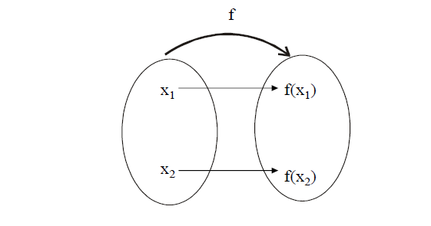
INJECTIVE or ONE-TO-ONE FUNCTION
Let f: X →Y be a function. f is injective or one-to-one if, and only if, ∀ x1, x2 ∈X,
if x1 ≠ x2 then f(x1) ≠ f(x2)That is, f is one-to-one if it maps distinct
points of the domain into the distinct points of the co-domain.
A one-to-one function separates points.

Slide 2
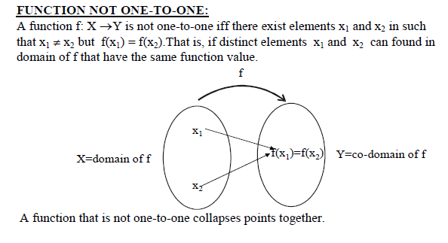

Slide 3
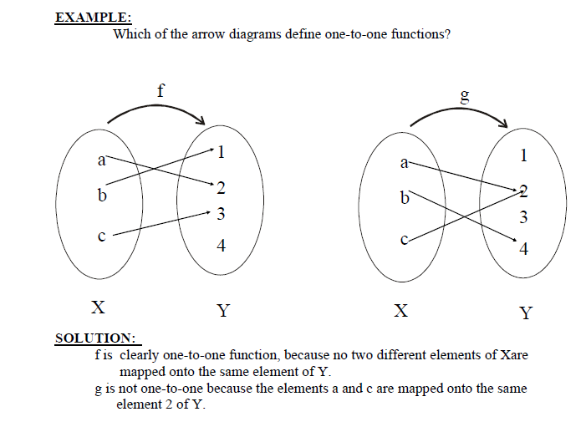

Slide 4
ALTERNATIVE DEFINITION FOR ONE-TO-ONE FUNCTION:
A function f: X →Y is one-to-one (1-1) iff ∀ x 1, x2 ∈X, if x1 ≠ x2 then f(x1)
≠ f(x2 ) (i.e distinct elements of 1st set have their distinct images in 2nd set)
The equivalent contra-positive statement for this implication is∀ x1, x2 ∈X,
if f(x1 ) = f(x2), then x1 = x2
REMARK:
f: X →Y is not one-to-one iff ∃ x1, x2 ∈X with f(x1) = f(x2) but x1 ≠ x2

Slide 5
EXAMPLE:
Define f: R →R by the rule f(x) = 4x - 1 for all x ∈R
Is f one-to-one? Prove or give a counter example.
SOLUTION:
Let x1, x2 ∈R such that f(x1) = f(x2)
⇒ 4x1 - 1 = 4 x2 – 1 (by definition of f)
⇒ 4 x1 = 4 x2 (adding 1 to both sides)
⇒ x1 = x2 (dividing both sides by 4)
Thus we have shown that if f(x1) = f(x2) then x1=x2
Therefore, f is one-to-one

Slide 6

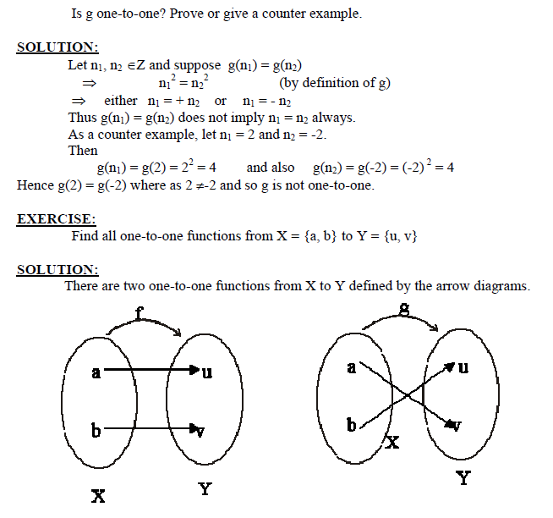

Slide 7
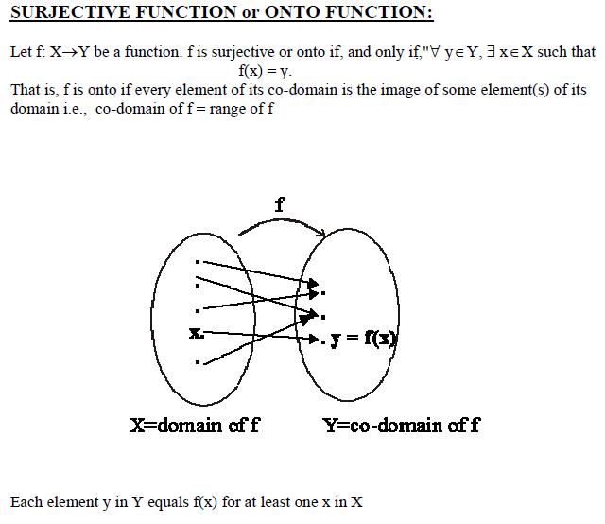

Slide 8
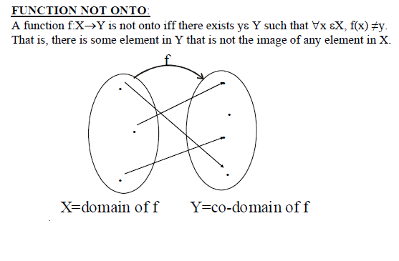

Slide 9
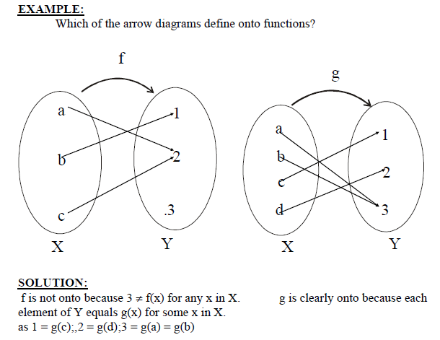

Slide 10
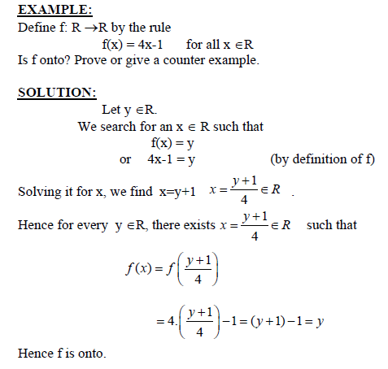

Slide 11
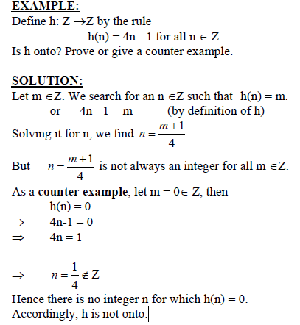

Slide 12
EXERCISE:
Let X = {1,5,9} and Y = {3,4,7}.Define g: X →Y by specifying that
g(1) = 7, g(5) = 3, g(9) = 4
Is g one-to-one? Is g onto?
SOLUTION:
g is one-to-one because each of the three elements of X are mapped to a different
elements of Y by g.
g(1) ≠ g(5), g(1) ≠ g(a), g(5) ≠ g(a)
g is onto as well, because each of the three elements of co-domain Y of g is the image of
some element of the domain of g.
3 = g(5), 4 = g(9), 7 = g(1)

Slide 13
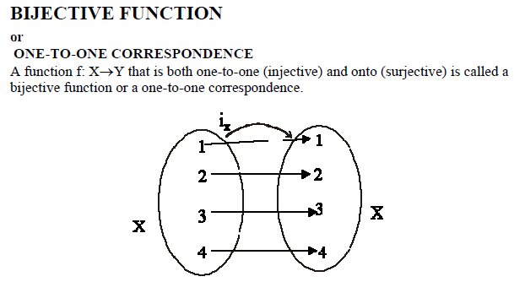

Slide 14
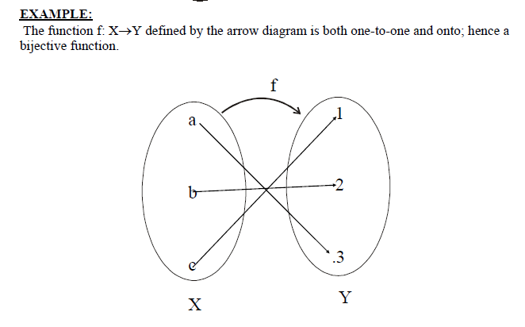

Slide 15
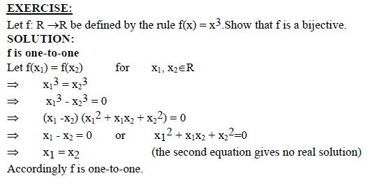

Slide 16
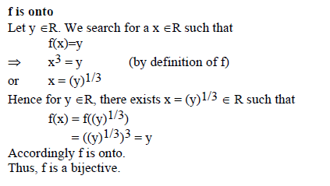

Slide 17
End of Lecture

